Slide 1
Clear Coverage User Guide
PROV_0818-CCUG-100007

Slide 2
Agenda
User Guide Sign-On Screen
Introduction
Logging In
Steps 1 through 13
Authorization Rules

Slide 3
Clear Coverage Sign-On Screen
A web-based system decision support application

Slide 4
Introduction
Welcome to Clear Coverage
This guide is used by to help you understand the basic navigation of Clear Coverage and how providers and other health care professionals will use this tool.

Slide 5
Logging In
Part 1
After entering your User Name and Password, you will need to select the appropriate Facility.
Sample Requesting Facility is used for Virginia Premier users to enter and submit authorizations (that will auto-approve or pend) and transfer to VITAL within 3-5 minutes.

Slide 6
Logging In
Part 2
Health Plan Super-Facility is used for Virginia Premier users to search all authorizations submitted from doctors or facilities outside of Virginia Premier.

Slide 7
Step 1
To start a new authorization select New Authorization from the Home screen (as shown below):
A)

Slide 8
Step 2
After selecting New Authorization, enter the required Patient Information.
There are two ways to search:
By Member Name and DOB. You will need to enter the member’s:
  Last Name
  First Name
  Date of Birth
By MRN Number (also known as the Subscriber ID).

Slide 9
Step 3
After entering the required member information, click on Search and verify you have the right member. Then click Select.
B. 1)

Slide 10
Step 4
After selecting the correct member, add the member to the request by clicking on the Add to Request button shown below:
C)

Slide 11
Step 5
Part 1
Once the user has added the member to the request, enter the Date of Service, select the Facility Name and the Requesting Clinician. After entering the required information, click on the Add to Request button tab.
D)

Slide 12
Step 5
Part 2
The following required information was entered below:
  Date of service
  Facility Name
  Requesting Clinician
  D. 1)

Slide 13
Step 6
After completing the requesting information, you will be required to enter the Diagnosis code. If you are entering multiple codes, you can separate them with a comma.
E)

Slide 14
Step 7
This screenshot displays multiple diagnosis codes separated with a comma. After entering the diagnosis codes, you will be required to click on the Add to Request button tab shown below.
E. 1)

Slide 15
Step 8
The service step requires users to enter the CPT/MCPC Code. If you are entering multiple diagnosis codes you can separate them with a comma, shown below.
F)

Slide 16
Step 9
This screenshot displays multiple CPT/MCPC Code codes separated with a comma. After entering the CPT/MCPC Code, you will be required to click on the Add to Request tab shown below.
F. 1)

Slide 17
Step 10
Part 1
The service information tab requires you to enter the Service Facility. Users will also be required to set the Modifiers, in which you choose if the service is a Rental or Purchase. Users also will be required to select the number of units of each service. The Modifier and Details Button are explained below.
G)

Slide 18
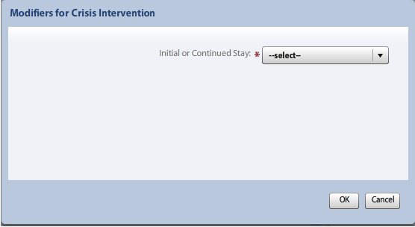
Step 10
Part 2
These screens show what will be displayed once the Modifiers and Details buttons have been selected. You will be required to select Modifier and the number of Units.

Slide 19
Step 10
Part 3
This screen shows how the service information tab will look once all required information in entered.
G. 2)
The additional notes tab is for you to enter any notes that want to enter, as well as attach any documents into the authorization. The notes and attachments are not required.

Slide 20
Step 11
Optional subtitle Arial 18pt, Dark Red
After completing the notes and attachments (when required), users are to ensure all information on all the tabs is accurate. Once verified, you may then submit the authorization by clicking on the Submit button.
H)

Slide 21
Step 11
CMHRS Registration and Authorization Forms
Use of the Portal is highly encouraged for CMHRS services.
  Forms will need to be attached to the portal authorization submissions
Registration Form
Initial Authorization Form
  ABA Behavior Therapy
  Day Treatment / PHP
  Intensive In-Home
  Intensive Community Treatment
  Mental Health Skill Building
  Psychosocial Rehabilitation
  Therapeutic Day Treatment for Adolescents / Children
Continued Stay Form

Slide 22
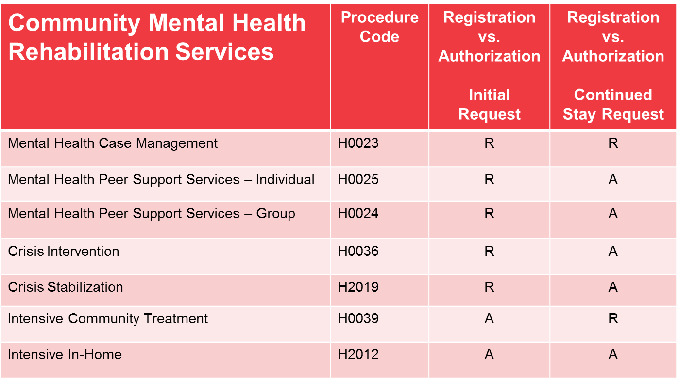
Step 1
CMHRS Registration vs. Authorization

Slide 23
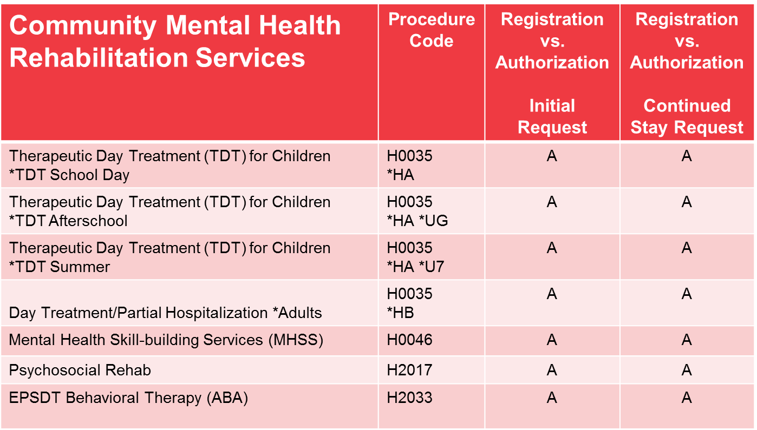
Step 11
CMHRS Registration vs. Authorization (continued)

Slide 24
Step 12
Once you have submitted the authorization you will be prompted to enter your contact information. The users name will auto-populate, and the user will be required to enter a phone number.

Slide 25
Step 13
Part 1
After entering your contact information, the user will be required to view and check that they have read the disclaimer and then click Yes to submit the request. On this screen, the user will also be able to submit another authorization request (optional) that can include if checked, requesting information and diagnoses.
J)

Slide 26
Step 13
Part 2
After you submit your authorization your Status will either automatically authorize or pend, which is displayed below.
K)

Slide 27
Clear Coverage – Authorization Rules
Part 1
Clear Coverage is configured to auto-approve or pend authorizations based on the Referral Coordinator (RC) Approval List and the NPA list. These guidelines are designated as “rules” and can be found in both VITAL and Clear Coverage.
To locate the rules applied to auto-approved or pended authorizations in VITAL, go to:
  Main, then
  Documents, then
  Notes
and look for note type “Clear Coverage”. The note containing the rule will state “Decision for Group Status”.

Slide 28
Clear Coverage – Authorization Rules
Part 2

Slide 29
Thank You

